Slide 1
A Multiperspective Fraud Detection Method for Multi-Participant E-commerce Transactions

Slide 2
INDEX
Abstract
Objective of project
Problem Statement
Scope & Motivation
Introduction
Literature survey
Existing Method
Disadvantages
Proposed method
Advantages
Project Flow
Hardware and Software Requirements
Architecture
Modules
References

Slide 3
ABSTRACT
In the realm of e-commerce, where transactions involve multiple participants such as buyers, sellers, and intermediaries, the detection of fraudulent activities presents a significant challenge. To address this issue, our proposed method focuses on a Mult perspective approach aimed at enhancing fraud detection accuracy and efficiency.
The first step involves the detection of user behaviors, wherein we leverage various techniques such as behavioral analysis and examination of transaction histories to gain insights into normal user behavior patterns. By understanding typical user interactions within the e-commerce ecosystem, we establish a baseline against which abnormal behaviors can be identified.
Subsequently, we delve into the analysis of abnormalities for feature extraction. Utilizing sophisticated anomaly detection algorithms, we scrutinize transaction data to uncover irregular patterns indicative of potential fraudulent activities. This process allows us to extract important features that serve as key indicators for fraud detection.

Slide 4
ABSTRACT
Finally, we employ an ensemble classification model to implement our fraud detection mechanism, avoiding reliance on a specific algorithm. Instead, we leverage the strengths of ensemble algorithms, such as Random Forest, Gradient Boosting, or AdaBoost. By feeding the extracted features into the ensemble model, we train it to discern between legitimate and fraudulent behaviors in multiparticipant e-commerce transactions. Ensemble methods are particularly well-suited for this task due to their ability to handle high-dimensional data and capture complex decision boundaries through the combination of diverse base models.
Keywords: Multiparticipant E-commerce Transactions, Fraud Detection, User Behaviors, Abnormalities Analysis, Ensemble Classification Model, Random Forest, Gradient Boosting, AdaBoost

Slide 5
OBJECTIVE OF PROJECT
The primary objective of this project is to develop an advanced fraud detection framework specifically tailored for multiparticipant e-commerce transactions, with a focus on integrating user behavior analysis, anomaly detection techniques, and ensemble classification to enhance the accuracy and efficiency of fraud detection, ultimately fostering a secure and trustworthy online transaction environment.

Slide 6
PROBLEM STATEMENT
The problem statement highlights the persistent challenge of insufficient fraud detection capabilities within multiparticipant e-commerce transactions. Existing methods often lack the sophistication needed to effectively identify fraudulent activities amidst complex transactional interactions. To address this, our project endeavors to pioneer a professional-grade solution by integrating advanced techniques, including user behavior analysis, anomaly detection, and ensemble classification. This holistic approach aims to bolster transaction security and instill trust among stakeholders in the e-commerce ecosystem.

Slide 7
SCOPE AND MOTIVATION
Motivation:- The motivation behind this project stems from the pressing need to fortify the security infrastructure of multiparticipant e-commerce transactions. With the exponential growth of online commerce, the prevalence of fraudulent activities poses a significant threat to both consumers and businesses alike. This project is driven by the aspiration to alleviate such concerns by pioneering an innovative fraud detection methodology. By leveraging cutting-edge techniques in user behavior analysis, anomaly detection, and ensemble classification, we aim to empower e-commerce platforms with the capability to effectively detect and mitigate fraudulent behaviors. Ultimately, our motivation lies in fostering a safer and more trustworthy online transaction environment, thereby enhancing consumer confidence and promoting sustainable growth in the digital marketplace.

Slide 8
SCOPE AND MOTIVATION
Scope :- The scope of this project encompasses the development and implementation of a multiperspective fraud detection method tailored specifically for multiparticipant e-commerce transactions. Key components within the scope include:
1. Analysis of User Behaviors: Understanding and profiling normal user behaviors within the e-commerce ecosystem.
2. Anomaly Detection: Identification and extraction of abnormal patterns and features indicative of potential fraudulent activities.
3. Ensemble Classification: Training and implementation of a ensemble classification model to distinguish between legitimate and fraudulent transactions.
4. Data Collection and Preprocessing: Collection of transactional data from e-commerce platforms and preprocessing it for analysis.

Slide 9
SCOPE AND MOTIVATION
5. Model Evaluation: Assessing the performance and effectiveness of the proposed fraud detection methodology using appropriate evaluation metrics.
6. Potential Extensions: Exploring opportunities for further research and enhancement of the proposed method, such as incorporating additional data sources or refining the classification model.
The project's scope is focused on providing a comprehensive solution to enhance fraud detection capabilities in multiparticipant e-commerce transactions, with the ultimate goal of fostering a more secure and trustworthy online transaction environment.

Slide 10
INTRODUCTION
In the rapidly evolving realm of e-commerce, transactions involving multiple participants present unique challenges in detecting and preventing fraud. This project introduces an innovative fraud detection method specifically crafted for multiparticipant e-commerce transactions. By integrating sophisticated techniques such as user behavior analysis, anomaly detection, and machine learning, our approach aims to provide a robust solution to enhance transaction security and safeguard against fraudulent activities in the digital marketplace.

Slide 11
LITERATURE SURVEY
S.NO | YEAR | AUTHORS | TITLE | OUT COMES
1 | IEEE, 2023 | Wangyang Yu; Yadi Wang; Lu Liu; Yisheng An; Bo Yuan; John Panneerselvam | A Multiperspective Fraud Detection Method for Multiparticipant E-Commerce Transactions | The article introduces a new fraud detection method for e-commerce, combining machine learning and process mining. It monitors real-time user behaviors, extracts features using abnormality analysis, and employs an SVM-based model. The approach proves effective in capturing dynamic fraudulent activities, offering a more efficient and timely fraud detection solution for e-commerce platforms.
2 | SSRN , 2020 | M. Abdelrhim, and A. Elsayed | The Effect of COVID-19 Spread on the e-commerce market: The case of the 5 largest e-commerce companies in the world. | The paper investigates how COVID-19 affected five major e-commerce companies globally: Amazon, Alibaba, Rakuten, Zalando, and ASOS. Using data from March 15 to May 25, 2020, it analyzes the daily stock returns of these companies in response to the pandemic. Results show that the number of COVID-19 cases and deaths significantly influenced their stock performance, with variations depending on the companies' countries of origin.

Slide 12
LITERATURE SURVEY
S.NO | YEAR | AUTHORS | TITLE | OUT COMES
3 | Cogent. Bus. Manag., 2021 | P. Rao et al., | The e-commerce supply chain and environmental sustainability: An empirical investigation on the online retail sector | The study finds that green consumerism shapes attitudes toward e-commerce, influencing usage intention. Perceived ease of use and usefulness outweigh environmental concerns in driving intention, but negative environmental attitudes still impact usage intention despite ease and usefulness considerations.
4 | Info. Econ., 2019 | E. A. Minastireanu, and G. Mesnita | An Analysis of the Most Used Machine Learning Algorithms for Online Fraud Detection | The paper reviews research on fraud detection in online financial transactions, focusing on various algorithms used. It introduces a new approach to selecting fraud detection techniques based on criteria like accuracy, coverage, and costs.

Slide 13
EXISTING SYSTEM
In the current fraud detection systems for e-commerce transactions, the predominant reliance on rule-based approaches and manual reviews has proven to be static and labor-intensive. This often results in delays and increased operational costs. Although some systems incorporate machine learning, they face challenges in adapting to multiparticipant scenarios and dealing with fragmented data sources. This underscores the necessity for a more comprehensive and adaptive solution.
To address these limitations, we propose integrating a Support Vector Machine (SVM) into the existing system. By introducing SVM, we aim to enhance the adaptability of the fraud detection mechanism in multiparticipant e-commerce transactions. SVM's proficiency in handling high-dimensional data and delineating complex decision boundaries makes it a suitable choice for improving accuracy and efficiency in fraud detection. This modification will contribute to creating a more responsive and adaptable solution, addressing the shortcomings of the current rule-based and manual review-heavy approach.

Slide 14
DISADVANTAGES
Sensitivity to Noise and Outliers: SVMs can be sensitive to noise and outliers in the data. Outliers or mislabeled data points can significantly impact the placement of the decision boundary, affecting the overall model performance.
Computational Intensity: Training an SVM can be computationally intensive, especially when dealing with large datasets. The time complexity of SVM algorithms can make them less efficient compared to some other machine learning models, particularly on big data scenarios.
Choice of Kernel: The performance of SVMs heavily relies on the choice of the kernel function. Selecting an inappropriate kernel or hyperparameter values can lead to suboptimal results. Tuning these parameters requires expertise and can be time-consuming.

Slide 15
DISADVANTAGES
Limited Interpretability: SVMs often provide accurate predictions, but the model itself may lack interpretability. Understanding how and why the model makes specific decisions can be challenging, especially in high-dimensional spaces.
Memory Usage: SVMs, especially in their non-linear form, can be memory-intensive, making them less suitable for deployment on resource-constrained devices or systems with limited memory.
Binary Classification: SVMs are inherently binary classifiers. While there are methods to extend them to handle multiple classes (e.g., one-vs-all), these extensions may not always perform as well as other models designed for multiclass classification.
Data Preprocessing and Scaling: SVMs are sensitive to the scale of input features. Therefore, proper preprocessing, including scaling, is essential. In scenarios where the features have different scales, normalization becomes crucial, and the absence of this step can lead to suboptimal results.

Slide 16
PROPOSED METHOD
Our proposed method for detecting fraud in multiparticipant e-commerce transactions represents a holistic approach that addresses the shortcomings of existing systems. It begins with an in-depth analysis of user behaviors, leveraging advanced algorithms to establish normal activity patterns within the e-commerce environment. Through anomaly detection techniques, deviations from these patterns are identified, signaling potential instances of fraud. Key features extracted from these anomalies serve as critical indicators for fraudulent activities.
The heart of our method lies in the implementation of a ensemble classification model, meticulously trained on the extracted features to discern between legitimate and fraudulent transactions with high precision. This robust model not only enhances accuracy but also provides scalability and adaptability to varying transaction volumes and complexities.

Slide 17
PROPOSED METHOD
Crucially, our method emphasizes continuous learning and adaptation, ensuring its effectiveness against evolving fraud tactics over time. By integrating cutting-edge technologies and methodologies, our proposed approach seeks to significantly improve the security and trustworthiness of multiparticipant e-commerce transactions, safeguarding businesses and consumers alike in the digital marketplace.

Slide 18
ADVANTAGES
Enhanced Accuracy: By leveraging advanced algorithms and feature extraction techniques, our method improves the accuracy of fraud detection, reducing false positives and negatives.
Efficiency: The use of machine learning algorithms streamlines the detection process, enabling faster identification of fraudulent transactions and minimizing operational delays.
Adaptability: Our method is designed to adapt to evolving fraud patterns and transactional dynamics, ensuring continued effectiveness in detecting new and emerging threats.
Scalability: With the scalability of machine learning models, our method can efficiently handle large volumes of transactions, making it suitable for growing e-commerce platforms.

Slide 19
ADVANTAGES
Comprehensive Detection: By integrating user behavior analysis, anomaly detection, and classification models, our method provides a comprehensive approach to fraud detection, covering a wide range of fraudulent activities.
Reduced Costs: The automation and efficiency of our method result in lower operational costs associated with manual reviews and fraud mitigation efforts.
Improved Trust: By effectively detecting and preventing fraudulent activities, our method enhances trust and confidence among consumers and businesses, fostering a secure e-commerce environment.

Slide 20
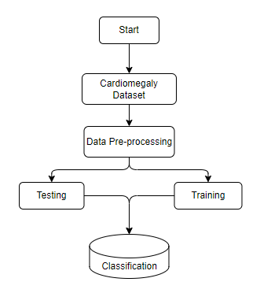
PROJECT FLLOW
Figure: work Flow of Proposed system

Slide 21
HARDWARE & SOFTWARE REQUIREMENTS
SOFTWARE REQUIREMENS
Operating System : Windows 7/8/10
Server side Script : HTML, CSS, Bootstrap & JS
Programming Language : Python
Libraries : Flask, Pandas, Mysql.connector, Os, Smtplib, Numpy
IDE/Workbench : PyCharm

Slide 22
HARDWARE & SOFTWARE REQUIREMENTS
SOFTWARE REQUIREMENS
Technology : Python 3.6+
Server Deployment : Xampp Server
Database : MySQL

Slide 23
HARDWARE & SOFTWARE REQUIREMENTS
HARDWARE REQUIREMENTS
Processor - I3/Intel Processor
RAM - 8GB (min)
Hard Disk - 128 GB
Key Board - Standard Windows Keyboard
Mouse - Two or Three Button Mouse
Monitor - Any

Slide 24
FUNCTIONAL AND NON-FUNCTIONAL REQUIREMENTS
Requirement’s analysis is very critical process that enables the success of a system or software project to be assessed. Requirements are generally split into two types: Functional and non-functional requirements.
Functional Requirements: These are the requirements that the end user specifically demands as basic facilities that the system should offer. All these functionalities need to be necessarily incorporated into the system as a part of the contract. These are represented or stated in the form of input to be given to the system, the operation performed and the output expected. They are basically the requirements stated by the user which one can see directly in the final product, unlike the non-functional requirements.

Slide 25
FUNCTIONAL AND NON-FUNCTIONAL REQUIREMENTS
Examples of functional requirements:
Authentication of user whenever he/she logs into the system
System shutdown in case of a cyber-attack
A verification email is sent to user whenever he/she register for the first time on some software system.
Non-functional requirements: These are basically the quality constraints that the system must satisfy according to the project contract. The priority or extent to which these factors are implemented varies from one project to other. They are also called non-behavioral requirements.

Slide 26
MODULES
1. System:
User
1.1 Create Dataset:
The e-commers dataset designated for classification is partitioned into training and testing sets, with a test size of 20-30%.
1.2 Pre-processing:
Dataset undergo data cleaning and data preprocessing, ensuring they are in the appropriate format for model training.
1.3 Training:
The pre-processed training dataset is employed to train the model, utilizing the ensemble algorithm and incorporating various ensemble learning methods to enhance performance.

Slide 27
Modules
1.4 Classification:
The model generates results by classifying e-commers values categories, distinguishing between fraud and not fraud cases.
2. User:
2.1 Provide Input:
Users are required to provide a input values for classification, providing the input data for the model.
2.2 View Results:
Users can view the results of the classification, gaining insights into the model's determination of whether the provided input is fraud or not.

Slide 28
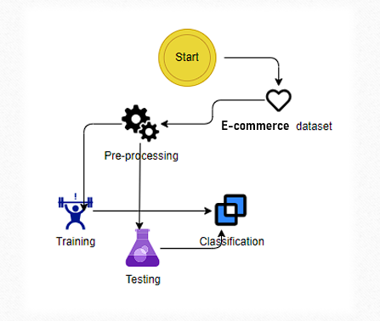
ARCHITECTURE

Slide 29
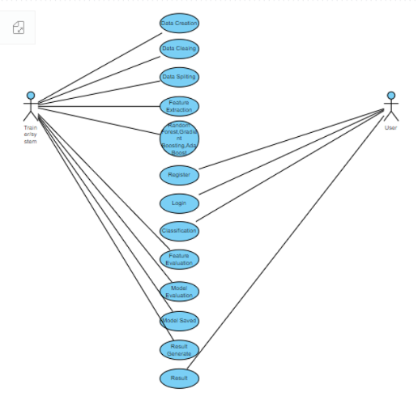
SYSTEM DESIGN
Use Case Diagram:
A use case diagram in the Unified Modeling Language (UML) is a type of behavioral diagram defined by and created from a Use-case analysis. Its purpose is to present a graphical overview of the functionality provided by a system in terms of actors, their goals (represented as use cases), and any dependencies between those use cases. The main purpose of a use case diagram is to show what system functions are performed for which actor. Roles of the actors in the system can be depicted.

Slide 30
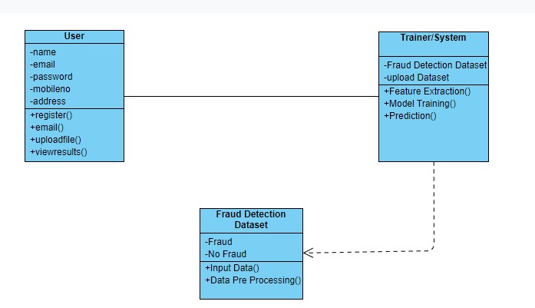
Class Diagram:
In software engineering, a class diagram in the Unified Modelling Language (UML) is a type of static structure diagram that describes the structure of a system by showing the system's classes, their attributes, operations (or methods), and the relationships among the classes. It explains which class contains information.

Slide 31
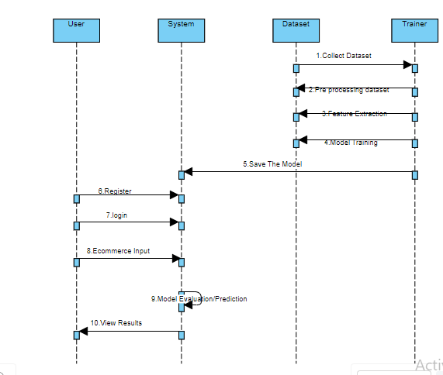
Sequence Diagram:
A sequence diagram in Unified Modelling Language (UML) is a kind of interaction diagram that shows how processes operate with one another and in what order. It is a construct of a Message Sequence Chart. Sequence diagrams are sometimes called event diagrams, event scenarios, and timing diagrams.

Slide 32
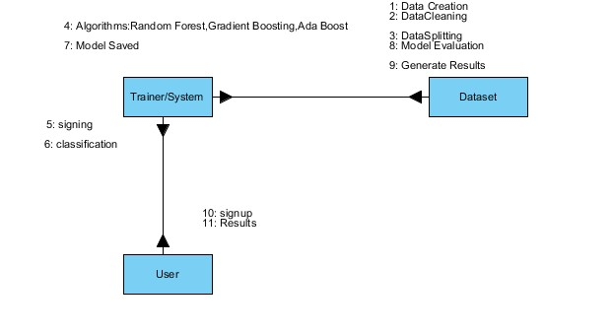
Collaboration Diagram:
In collaboration diagram the method call sequence is indicated by some numbering technique as shown below. The number indicates how the methods are called one after another. We have taken the same order management system to describe the collaboration diagram. The method calls are similar to that of a sequence diagram. But the difference is that the sequence diagram does not describe the object organization whereas the collaboration diagram shows the object organization.

Slide 33
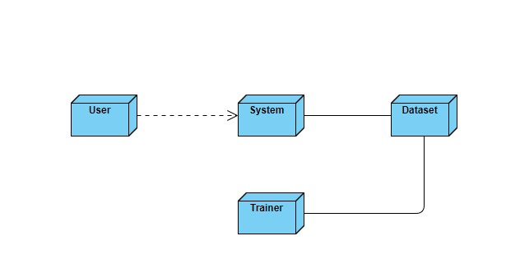
DEPLOYMENT DIAGRAM
Deployment diagram represents the deployment view of a system. It is related to the component diagram. Because the components are deployed using the deployment diagrams. A deployment diagram consists of nodes. Nodes are nothing but physical hardware’s used to deploy the application.

Slide 34
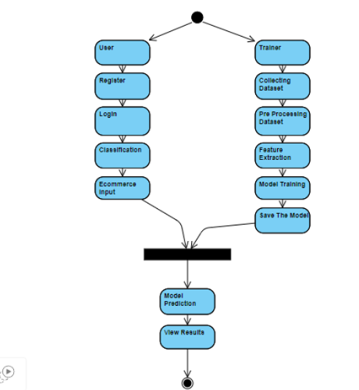
Activity Diagram:
Activity diagrams are graphical representations of workflows of stepwise activities and actions with support for choice, iteration and concurrency. In the Unified Modelling Language, activity diagrams can be used to describe the business and operational step-by-step workflows of components in a system. An activity diagram shows the overall flow of control.

Slide 35
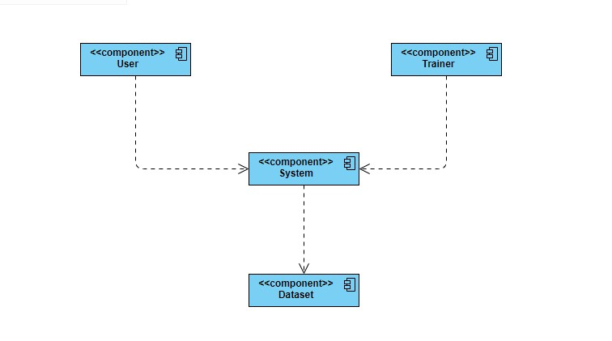
Component Diagram:
A component diagram, also known as a UML component diagram, describes the organization and wiring of the physical components in a system. Component diagrams are often drawn to help model implementation details and double-check that every aspect of the system's required functions is covered by planned development.

Slide 36
ER Diagram:
An Entity–relationship model (ER model) describes the structure of a database with the help of a diagram, which is known as Entity Relationship Diagram (ER Diagram). An ER model is a design or blueprint of a database that can later be implemented as a database. The main components of E-R model are: entity set and relationship set.
An ER diagram shows the relationship among entity sets. An entity set is a group of similar entities and these entities can have attributes. In terms of DBMS, an entity is a table or attribute of a table in database, so by showing relationship among tables and their attributes, ER diagram shows the complete logical structure of a database. Let’s have a look at a simple ER diagram to understand this concept.

Slide 37
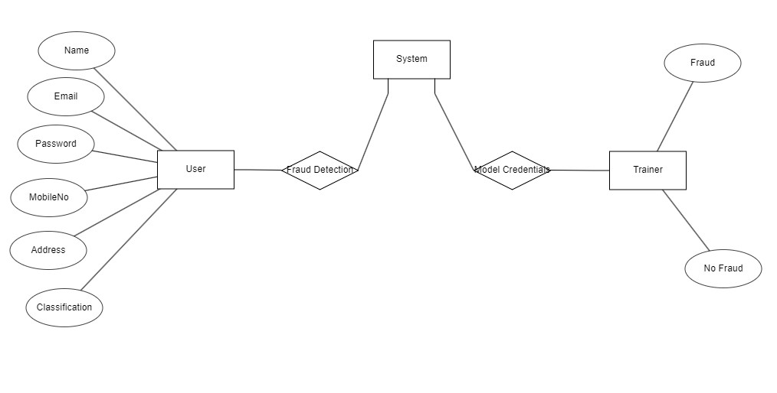

Slide 38
DFD Diagram:
A Data Flow Diagram (DFD) is a traditional way to visualize the information flows within a system. A neat and clear DFD can depict a good amount of the system requirements graphically. It can be manual, automated, or a combination of both. It shows how information enters and leaves the system, what changes the information and where information is stored. The purpose of a DFD is to show the scope and boundaries of a system as a whole. It may be used as a communications tool between a systems analyst and any person who plays a part in the system that acts as the starting point for redesigning a system.

Slide 39
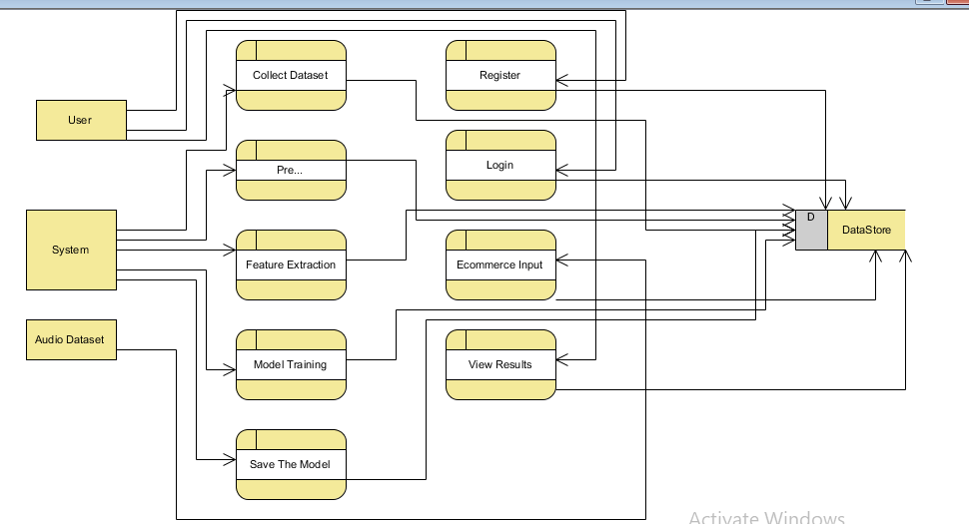

Slide 40
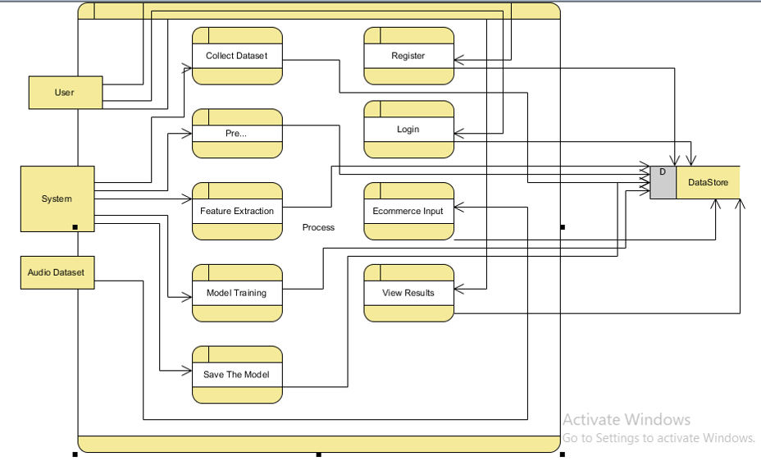

Slide 41
Result
In our multi-perspective Fraud Detection project, we evaluated Random Forest, Gradient Boosting, and AdaBoost algorithms, ultimately selecting Random Forest as our final model due to its superior performance in accuracy, handling of complex data, and robust fraud detection capabilities. Despite the strengths of Gradient Boosting and AdaBoost, Random Forest's ability to effectively manage overfitting and its efficiency in processing and classifying transactional data made it the most suitable choice for our system. This decision supports our goal to provide a reliable, scalable, and highly urate fraud detection solution.

Slide 42

Output Screens
REGISTRATION AND LOGIN PAGE:

Slide 43

REGISTRATION PAGE:

Slide 44

LOGIN PAGE:

Slide 45
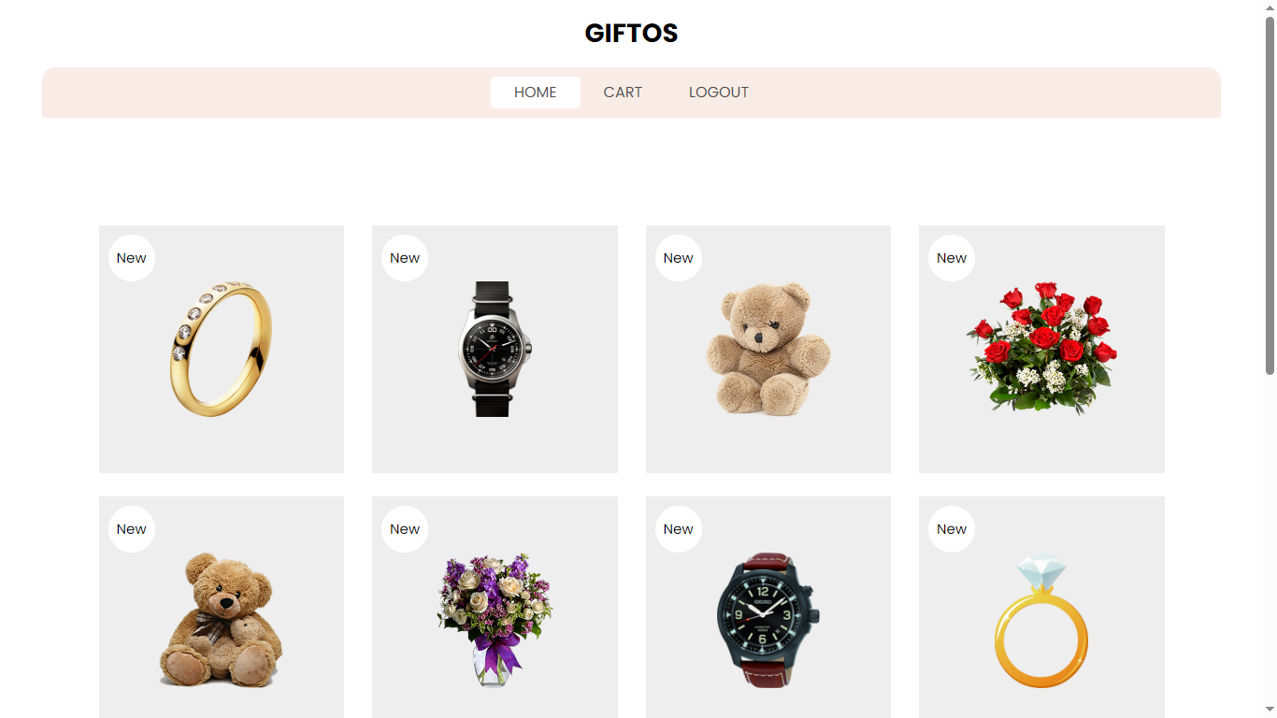
HOME PAGE:

Slide 46
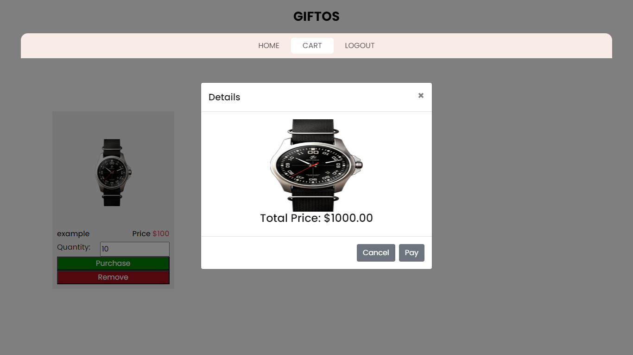
CART PAGE:

Slide 47
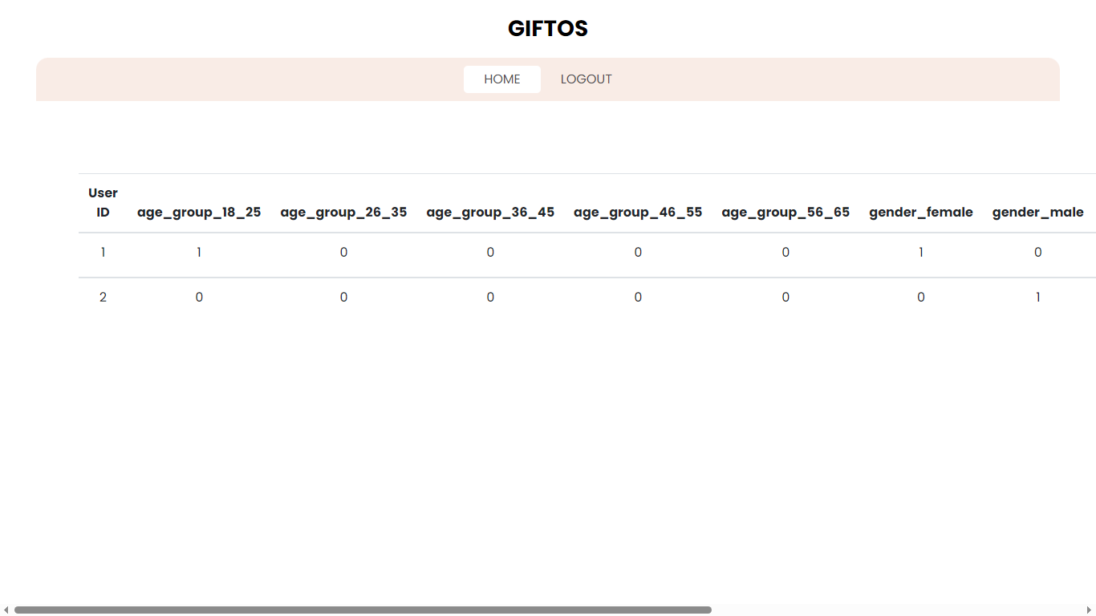
USER DATA PAGE:

Slide 48
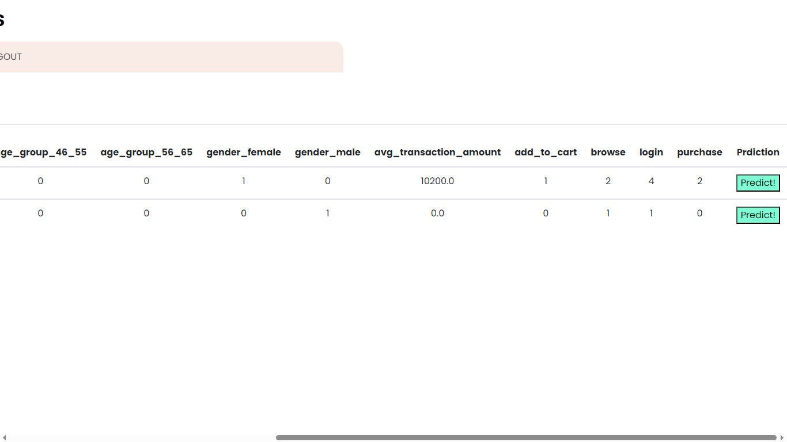
PREDICTION PAGE:

Slide 49
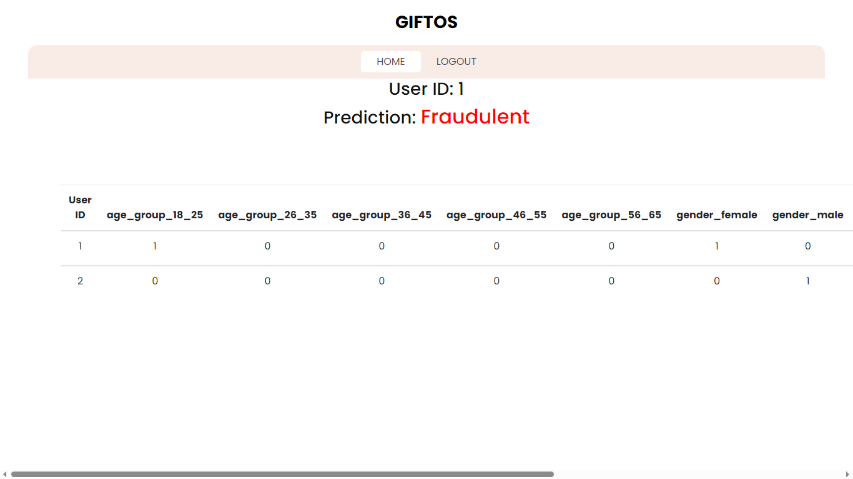
RESULT PAGE:

Slide 50
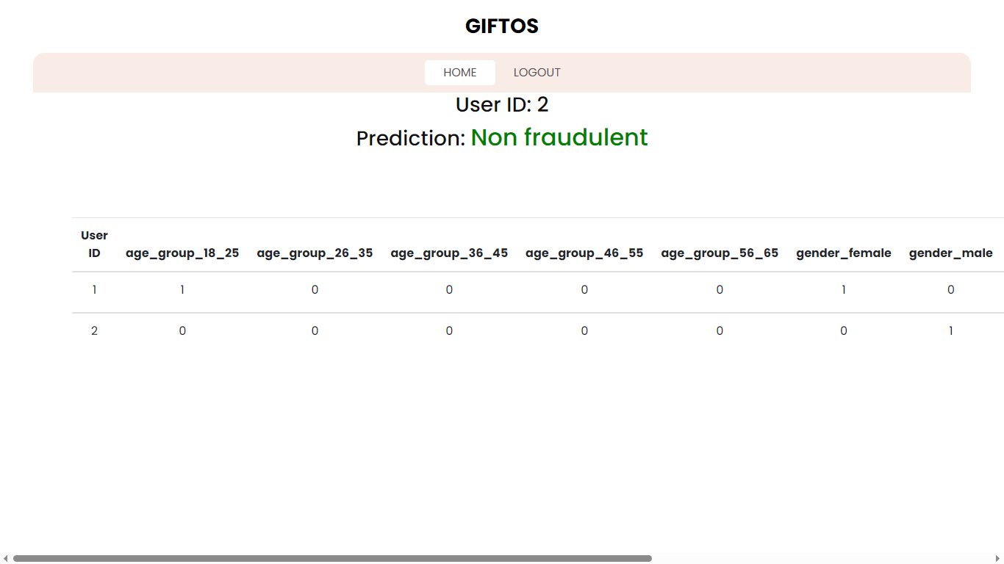
RESULT PAGE:

Slide 51
Conclusion
In conclusion, our exploration into developing a state-of-the-art fraud detection system highlighted the importance of choosing the right algorithm to address the complex and dynamic nature of fraudulent transactions. Through rigorous testing and evaluation of Random Forest, Gradient Boosting, and AdaBoost, we determined that Random Forest stands out as the most effective tool in our arsenal against fraud. Its exceptional performance on various metrics, including accuracy, precision, and its ability to mitigate overfitting, underscored its suitability for our needs. The process also underscored the critical role of data preprocessing and the thoughtful design of input and output components in enhancing model performance and usability. As we move forward, the adoption of the Random Forest algorithm in our Fraud Detection system represents a significant step towards achieving high levels of security and trust, essential in today's digital transaction environments. This project not only showcases the capabilities of machine learning in fraud detection but also sets the stage for future enhancements and adaptations as fraud techniques evolve.

Slide 52
FUTURE ENHANCEMENT
Future enhancements for our Fraud Detection system will focus on integrating deep learning for more sophisticated pattern recognition, implementing real-time processing to minimize fraud impact, and improving anomaly detection. We'll also refine feature engineering, incorporate Explainable AI for better decision transparency, and introduce adaptive learning mechanisms to automatically adjust to new fraud trends. Expanding the system's capabilities across various industries and enhancing collaboration tools for sharing fraud insights are also key objectives. These advancements aim to enhance the system's accuracy, efficiency, and adaptability, ensuring it remains effective against evolving fraudulent activities.

Slide 53
REFERENCES
W. Yu, Y. Wang, L. Liu, Y. An, B. Yuan and J. Panneerselvam, "A Multiperspective Fraud Detection Method for Multiparticipant E-Commerce Transactions," in IEEE Transactions on Computational Social Systems, doi: 10.1109/TCSS.2022.3232619.
M. Abdelrhim, and A. Elsayed, “The Effect of COVID-19 Spread on the e-commerce market: The case of the 5 largest e-commerce companies in the world.” Available at SSRN 3621166, 2020, doi: 10.2139/ssrn.3621166.
P. Rao et al., “The e-commerce supply chain and environmental sustainability: An empirical investigation on the online retail sector.” Cogent. Bus. Manag., vol. 8, no. 1, pp. 1938377, 2021.

Slide 54
REFERENCES
4. S. D. Dhobe, K. K. Tighare, and S. S. Dake, “A review on prevention of fraud in electronic payment gateway using secret code,” Int. J. Res. Eng. Sci. Manag., vol. 3, no. 1, pp. 602-606, Jun. 2020.
5. A. Abdallah, M. A. Maarof, and A. Zainal, “Fraud detection system: A survey,” J. Netw. Comput. Appl., vol. 68, pp. 90-113, Apr. 2016.
6. E. A. Minastireanu, and G. Mesnita, “An Analysis of the Most Used Machine Learning Algorithms for Online Fraud Detection,” Info. Econ., vol. 23, no. 1, 2019.

